Slide 1
DCO and Data Science, best friends forever!
A noobs journey into data science, and how you can start your journey

Slide 2
Who I am and what are we doing here
Not a Data Scientist, but stayed at a Holiday Inn
I have spent 15+ years supporting DCO in a variety of roles.
Network Monitoring
Engineering
Training/teaching and Exercises
Recently had a role dumped on me to do more advanced analytics on mostly PCAP traffic
Here is some of what I have learned in that process

Slide 3
Machine Learning overview

Slide 4
Types of machine learning
Supervised
Training data must be labelled
Unsupervised
Training data is not labelled
Natural Language Processing
Works with unstructured text

Slide 5
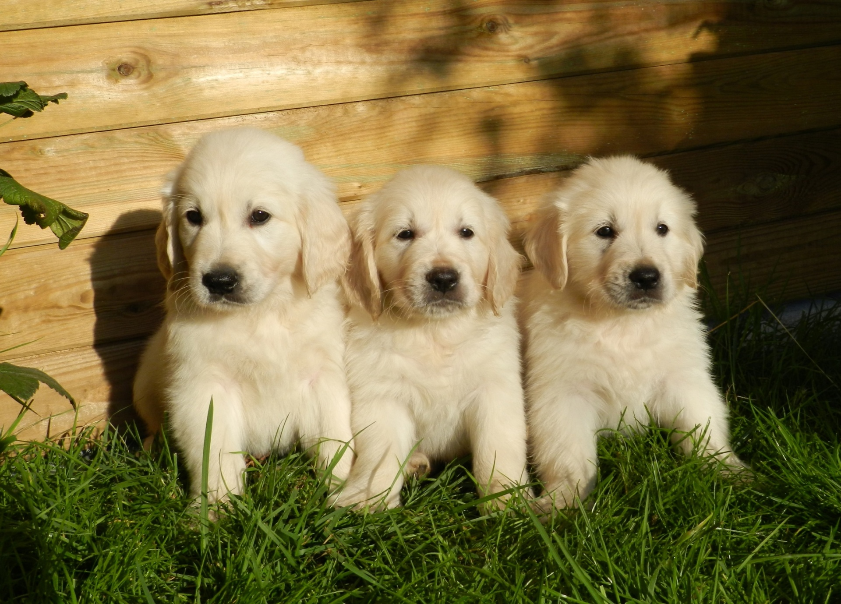
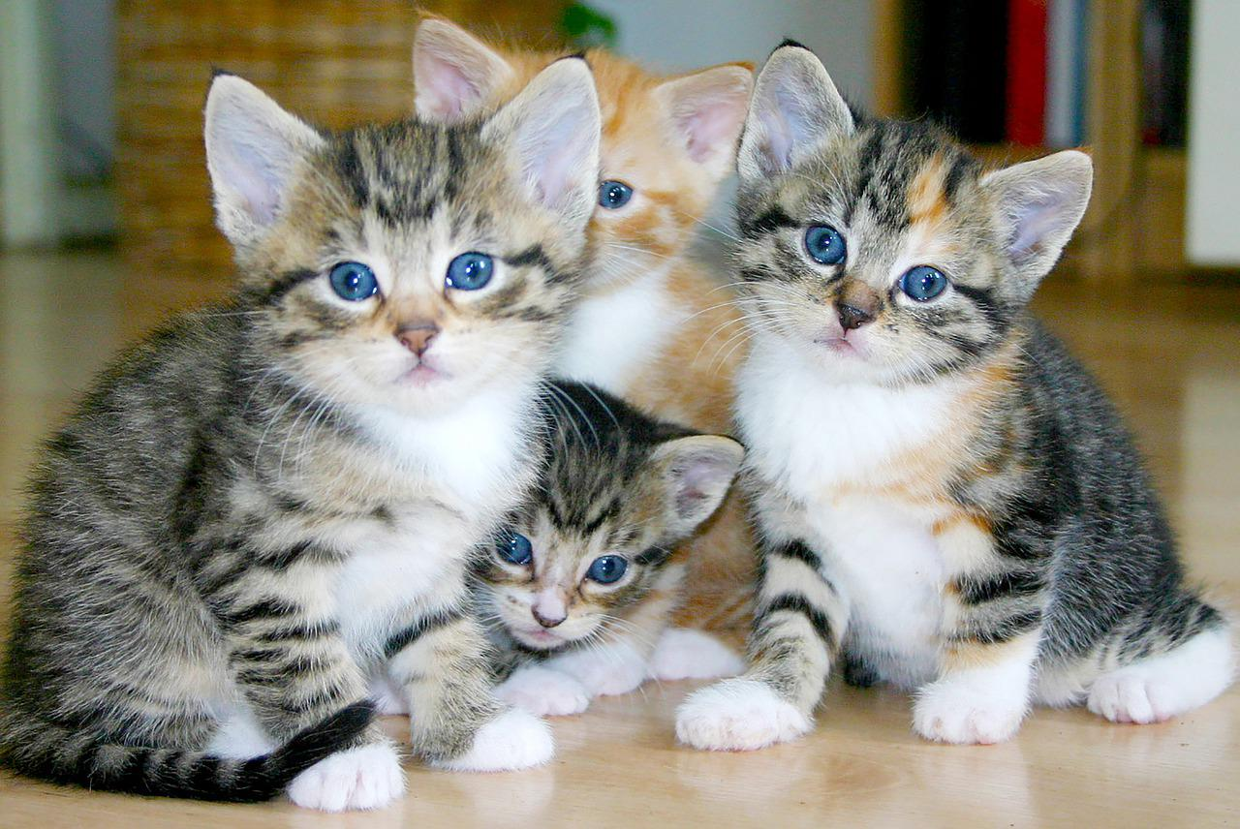
Supervised
Types
Classification – Data is labelled, and it learns what that data is based on the label for future use
Dog
Cat

Slide 6

Supervised
Sample Classification Algorithm: Naïve Bayes
Labels are called “features”
Evaluate each feature based on these features and assign a probability based on whether you can predict what that item is
Need a “response” (i.e., did an event occur?)
Adjust percentages as you continue whether you are correct or wrong

Slide 7
Supervised
Classification Example
Some uses outside of CND:
Image detection
Some uses within security:
Image captchas (click on all the cross walks)
SPAM detection
Antivirus
SIEM Alarms relevance

Slide 8

Supervised
Regression – Looks for relationships and patterns between data and how they are related. Continuous value to look for.

Slide 9
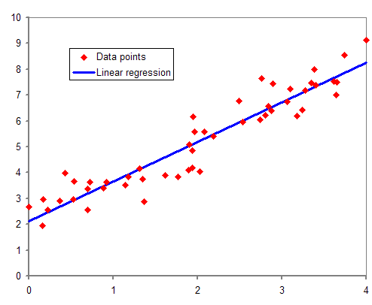
Supervised
Sample Regression Algorithm: Linear Regression
Looking for historical data to predict the future
Generating a trend based on data points

Slide 10
Supervised
Regression Example
Some uses outside of CND:
Forecasting prices of goods
Forecasting stock prices
Some uses within security:
Monitoring average bandwidth usage by system

Slide 11


Unsupervised
Types
Clustering – Groups objects that share similarities
Notes:
Scribbs start

Slide 12
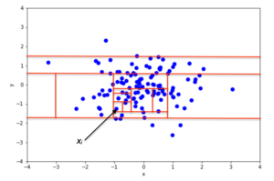
Unsupervised
Sample Anomaly Algorithm: Isolation forest
Looks for anomalies of data points within a given set of features
Given an anomaly score to each set of features
You can choose what percentage of anomalies you want to take or let the algorithm decide based on the data

Slide 13
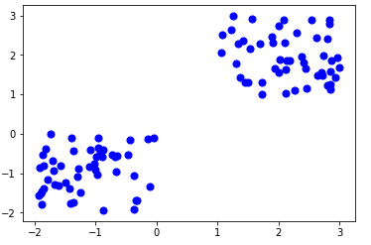
Unsupervised
Sample Clustering Algorithm: K-means
Plotting data points to so that data points are placed in unique groups
Are there patterns in your data set?
Can this be used to predict future outcomes?

Slide 14
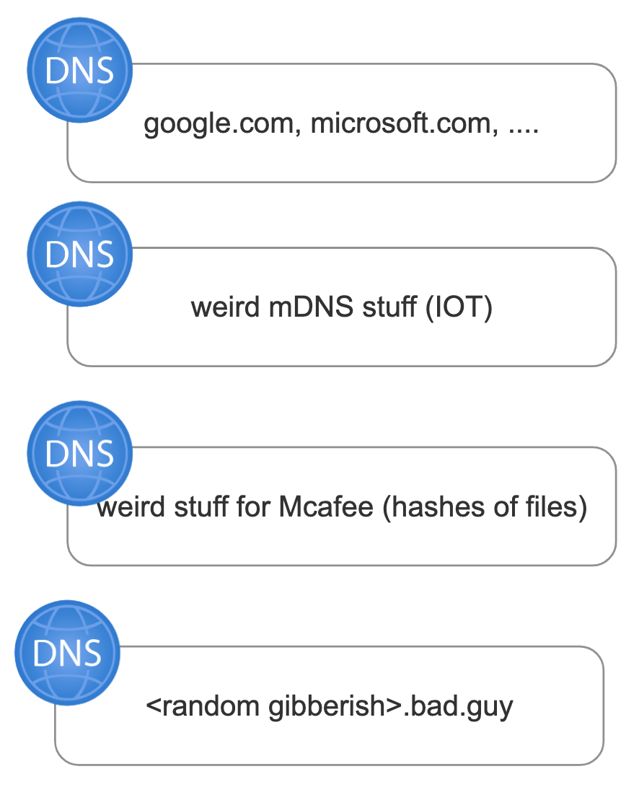
Unsupervised
Clustering Example
Some uses outside of CND:
Group websites together based on content
Some uses within security:
Sorting processes by their actions (network, files written, etc)
Clustering Example continued
Sort all DNS queries into buckets using IsolationForest based on frequency, length and overall “entropy”
See what the buckets look like and chart it

Slide 15
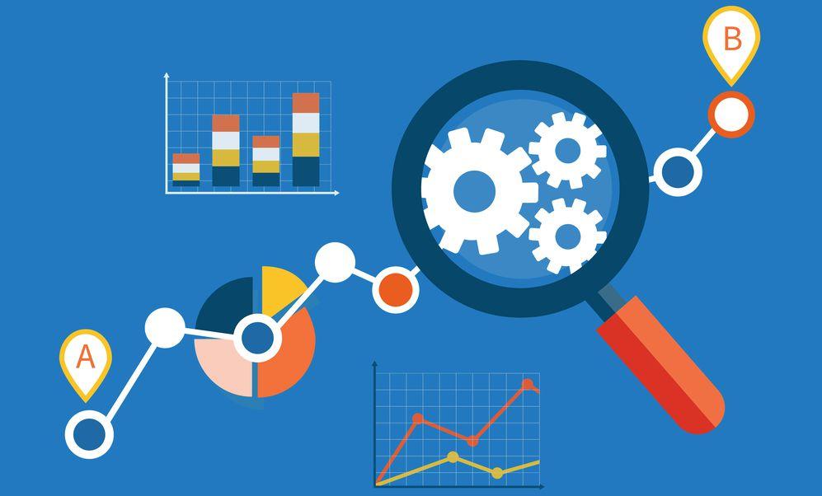
Unsupervised
Association – Find associations between data which you don’t understand if there are relationships

Slide 16

Unsupervised
Sample Clustering Algorithm: Apriori
“From what was before”
Given a pile of data, do certain items appear together?
Itemsets: Collection of items (ex. what was bought)
Support: If people buy X, do they also by Y?
Confidence: Is this always the case?
Lift: How unique is Y to X?

Slide 17
Unsupervised
Uses outside of CND:
Buying habits relationships
Association Example
Tracking user’s patterns
Logon/off time
Programs run by them
Utilization of administrative functions

Slide 18
Data Science Process in Python

Slide 19
Basic flow of Python Applications
Gather data from the source
Format the data into something that can be utilized and place in a dataframe
Enrich the data into “Features”
Process data
Present this information in some meaningful manner
Gather
Data frame
Enrich
Process
Present

Slide 20
Gather
Data frame
Enrich
Process
Present
Where will you pull the logs from?
Logs can come from:
Files
Structured data source such as a database or Big Data Platform
REST APIs
Host events
How easy this data will be worked with?

Slide 21
Gather
Data frame
Enrich
Process
Present
Data Frames are the most fundamental object in data science
Data frame simply is a 2D dictionary on steroids in Python and is Iterable….. BUT DON’T do it!
Data Frames have a number of more efficient methods that allow you to process the data
There are a number of easy methods to pull DCO log data into Dataframes:
All XML data (Windows Logs) is easy to pull in
ZAT allows users to pull in Zeek logs
Eland allows you to connect to Elasticsearch and pull data

Slide 22

Data frame Libraries: Pandas
Likely the most widely supported data frame library
Super easy to use
Fast as it operates completely out of memory
Not easily scalable across multiple systems

Slide 23

Data frame Libraries: PySpark
Better for scaling horizontally
A wrapper for Spark (a Java library)
Loosely based Hadoop (Map, Reduce)
Utilizes “Lazy Evaluation”
More complicated to use

Slide 24

Data frame Libraries: Eland
Created by Elasticsearch
Strives to be “Pandas” like
Utilizes Elasticsearch as a backend and uses memory as a cache only
Slower as you are relying on disk
Can convert to Pandas easily if desired

Slide 25
Gather
Data frame
Enrich
Process
Present
Gathering value out of the data
A number of functions can be utilized for this:
Getting unique values of a field
Counting values in a field
Utilizing regular expressions
Calculating mean, median, mode
Calculating entropy
Formatting fields properly
Pandas has a lot of functionality built in to make this easy
Learn to be comfortable with lambda which allows you to pass an expression into code.. You will need it

Slide 26
Gather
Data frame
Enrich
Process
Present
Send your enriched data frame into a variety of available machine learning and statistical
Supervised
Classification
Regression Algorithms
Unsupervised
Clustering
Association

Slide 27
Gather
Data frame
Enrich
Process
Present
Figure out the best method to present the summary data you are looking for
Simple List
Interactive charts can be made using a variety of libraries
Plotly
Matplotlib
Seaborn

Slide 28
Not one, but THREE Demos!
All the demos were created to be doable on a moderately speced computer, not to scale to a large dataset
Demos
Machine Learning on Zeek Logs- evaluating sub-domains to see if we can detect DNS tunelling
Data Analytics on Apache Logs – Looking at patterns of requests to see if we can train a model to find future issues
Machine Learning on Sysmon logs – Evaluating executables in an environment to see if it is possible to detect “odd” executables
https://github.com/sealingtech/DCO_Notebooks

Slide 29
What I have learned
Machine learning isn’t magic… you either need to train on the front end (supervised) or on the backend (unsupervised)
At least at this time I wouldn’t be comfortable blocking based on machine learning.. Maybe some day
HOWEVER…
Where I see the value is in taking out manual searching for a lot of things that operators have developed “intuition” about
Automate the simple… so you can use your brain for the harder challenges
Building scalable algorithms can be difficult
https://github.com/sealingtech/DCO_Notebooks

